Slide 1
Chapter 4 Operational Amplifier

Slide 2
Contents
Structures and Characteristics
Inverting Configuration
Non-Inverting Configuration
Superposition in Circuits with Op-Amp.
Integrator
Differentiator
Filters with Op-Amp
Impedances in Circuits with Op-Amp

Slide 3
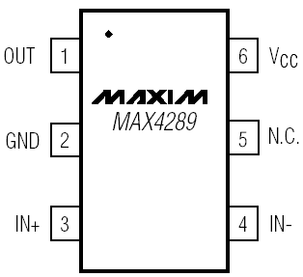
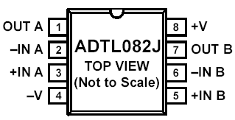
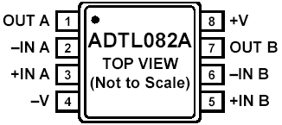
1. Structures and Characteristics
v₁
−
+
A
v₂
+
V_{out}
−
0

Slide 4
Characteristics of Perfect Op-Amp
v₁
−
+
Independent of R_{L}
Z_{i1}
A
v₂
+
v_{out} = A (v₂-v₁)
−
Z_{i2}
R_{L}
Almost no current
0
Infinite input impedance
Zero output impedance
Very high (infinite) gain
Typical A= 10⁴ ~ 10⁷

Slide 5
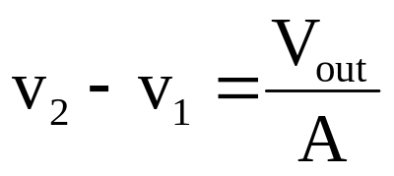
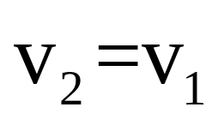
Virtual Short & Virtual Open
v₁
−
+
i
v₂
+
v_{out} = A (v₂-v₁)
−
Almost no current
0
In terms of voltage
due to infinite gain
A
→
∞
→
0
Virtual short
In terms of current
due to infinite input impedance
Z
→
∞
i = 0
Virtual open

Slide 6
2. Inverting Configuration
“inverting” means …
R₁
R₂
i₂
v₁
−
+
i₁
v_{s}
+
−
+
v_{out}
−
v₂
In terms of voltage
→ virtual short
→ v₁=v₂=0
Find the currents.
i₁= V_{S} / R₁
i₂ = － V_{out}/ R₂

Slide 7
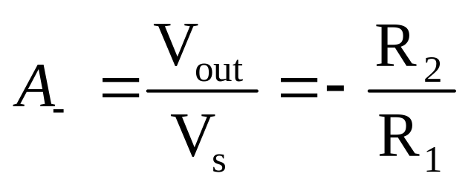
R₂
i₁= V_{S} / R₁
R₁
i₂
−
+
i₂ = － V_{out}/ R₂
v₁
i₁
v_{s}
+
−
+
v_{out}
−
v₂
Infinite input impedance
i₁ = i₂
V_{out}= −V_{S} R₂/ R₁
Virtual Open

Slide 8
A Summary for Inverting Configuration
R₁
R₂
i₂
v₁
−
+
i₁
v_{s}
+
−
+
v_{out}
−
v₂

Slide 9
Example 1
1MΩ
virtual short →
v₁=v₂=0
10 kΩ
v₁
−
+
v_{s}
+
−
100Ω
+
V_{out} =?
−
v₂
50Ω
−100 V_{S}
The resistor between the input terminals has no effect on the gain of ideal operational amplifier
Since virtual short is in parallel with the resistor

Slide 10
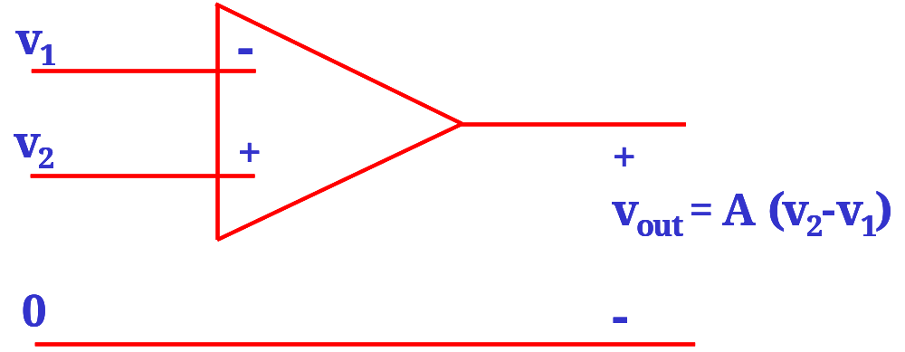
Steps of Analysis
1. Find the potentials at the + or - input terminals
2. Using virtual short equate the potentials at + & - terminals
3. Using virtual open find the current flowing into the feedback resistor
4. Calculate the output voltage

Slide 11
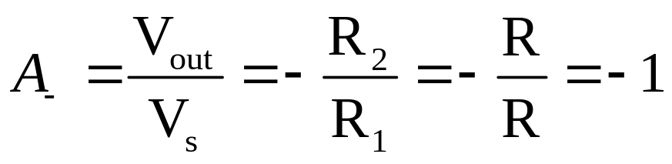
Example 2 --- Inverter
R
R
i₂
v_{s}
i₁
v₁
−
+
+
V_{out}
−
v₂
V_{out}= −V_{S}

Slide 12
Example 3
0.125kΩ
v₄
0.25kΩ
Please find V_{out}
v₃
0.5kΩ
1KΩ
v₂
10kΩ
1kΩ
10kΩ
v₁
−
+
−
+
+
v_{out}
−
V_{out}= 8v₄+ 4v₃+2v₂+v₁

Slide 13
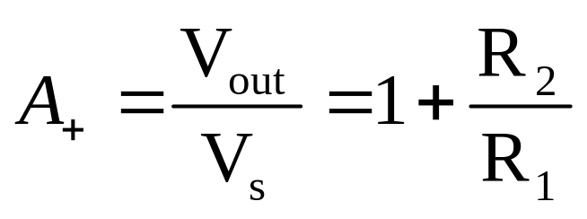
3. Non-inverting Configuration
R₂
Find i₁ & i₂
R₁
i₂
i₁= −V_{S} /R₁
i₁
v₁
−
+
i₂= (V_{S}－V_{out}) / R₂
v₂
+
V_{out}
−
v_{s}
+
−
i₁ = i₂
Find v₁ & v₂
Virtual short → v₁= v₂ = V_{S}

Slide 14
A Summary for Non-inverting Configuration
R₂
R₁
i₂
i₁
v₁
−
+
v₂
+
V_{out}
−
v_{s}
+
−

Slide 15
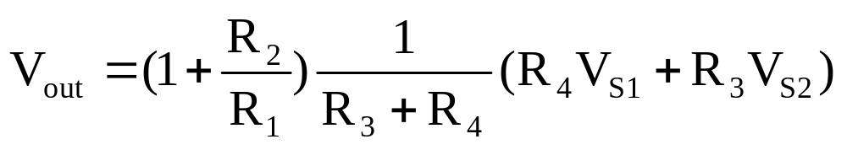
Example --- Adder
Signal addition can also be done with non-inverting configuration.
R₂
R₁
v₁
−
+
v₂
R₃
R₄
+
V_{out} =?
−
We will analyze this circuit later.
+
−
+
−
v_{s1}
v_{s2}

Slide 16
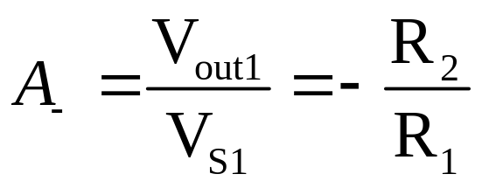
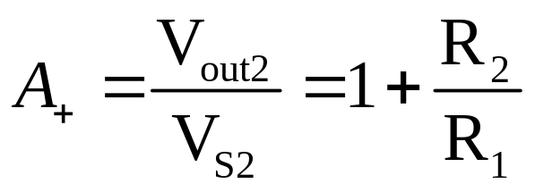
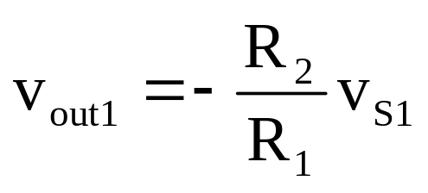
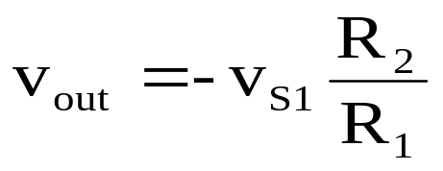
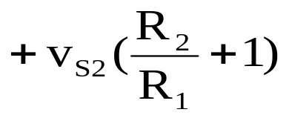
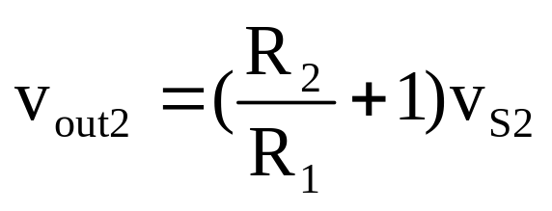
4. Superposition in Circuits with Op-Amp.
R₂
R₁
−
+
v_{s1}
+
−
+
v_{out}
−
v_{s 2}
+
−
Without v_{S2}
Without v_{S1}

Slide 17
Summary
for Inverting Configuration
R₁
R₂
v₁
−
+
+
v_{out}
−
v_{s}
+
−
v₂
for Non-inverting Configuration
R₁
R₂
v₁
−
+
v₂
+
V_{out}
−
v_{s}
+
−

Slide 18
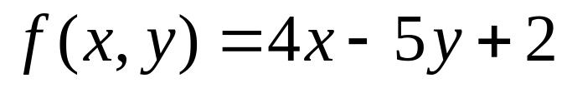
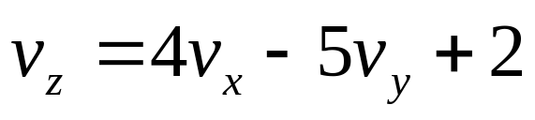
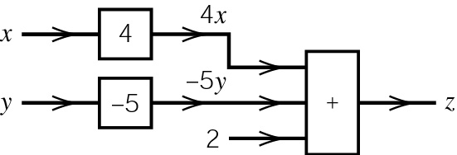
Exercise: Implementing Linear Algebra
Converting this to circuit language
We can now build a circuit diagram

Slide 19
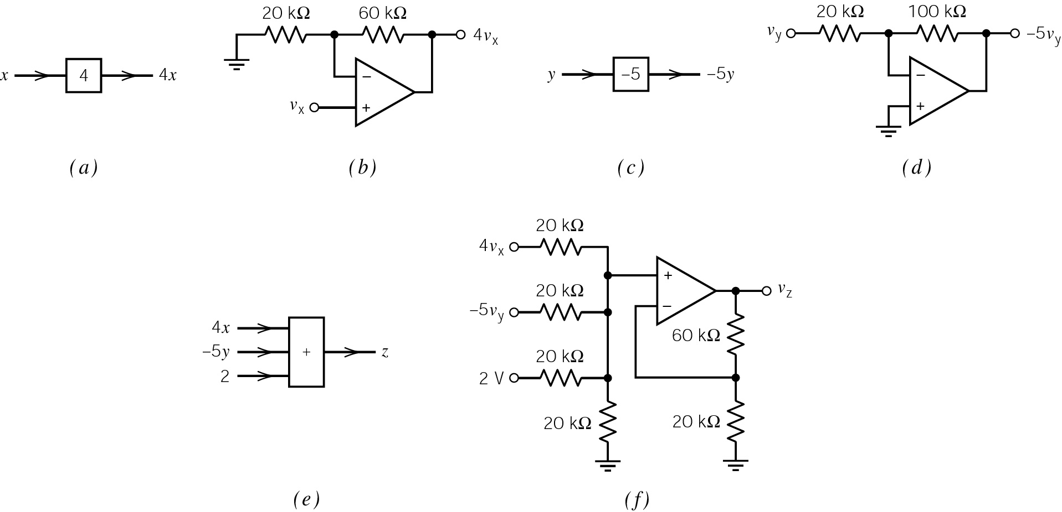

Slide 21
Contents
Integrator
Differentiator
Filters with Op-Amp
Impedances in Circuits with Op-Amp

Slide 22
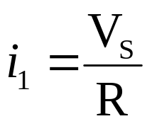

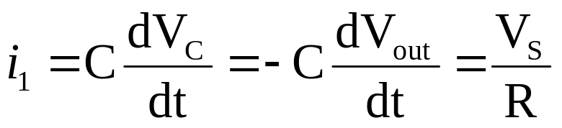
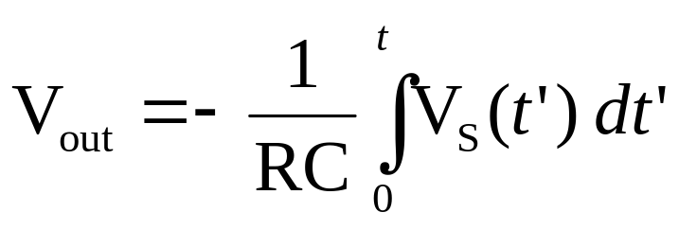
Integrator
Assume V_{S}= 0 and V_{C}= 0 for t<0
C
R
i₂
+V_{C}－
i₁
−
+
v_{s}
+
−
+
v_{out}
−
V_{out}= −V_{C}

Slide 23
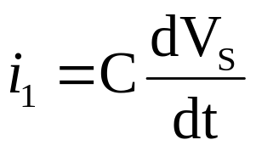
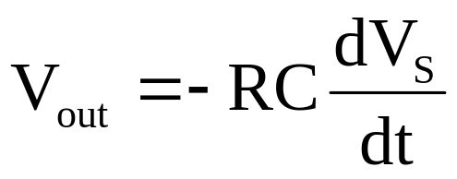
Differentiator
R
C
i₂
i₁
−
+
v_{s}
+V_{S}－
+
−
+
v_{out}
−
i₂= −V_{out}/ R

Slide 24
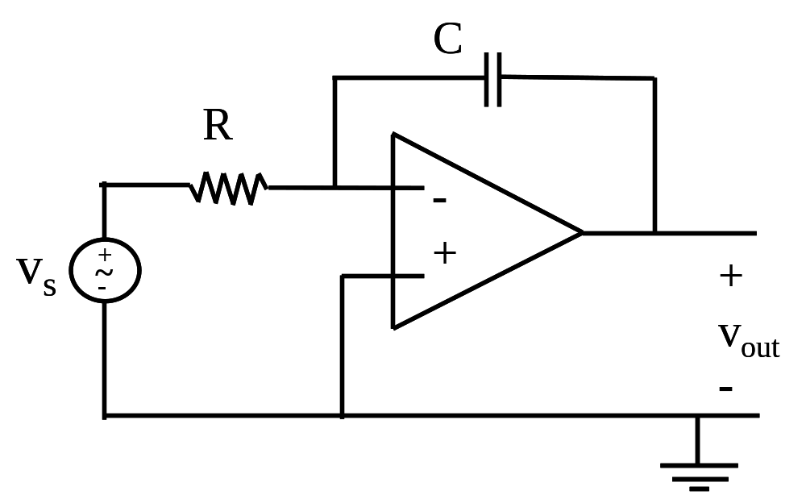
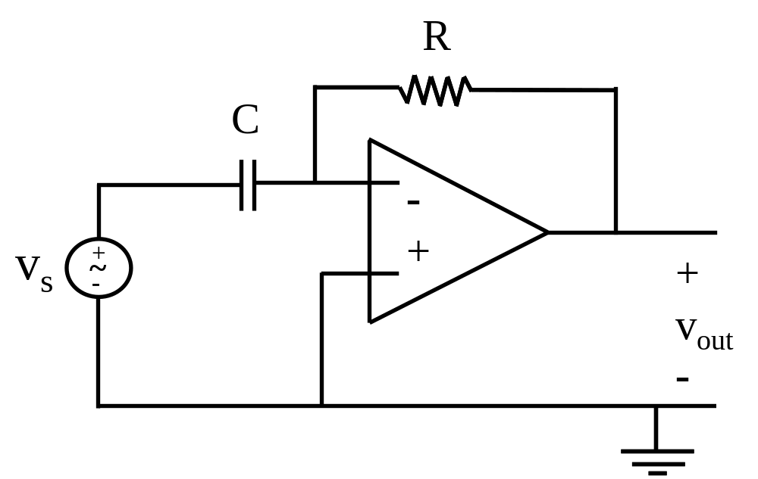
A Summary
Integrator
Differentiator

Slide 25
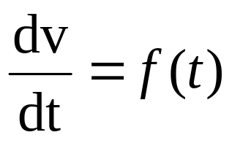
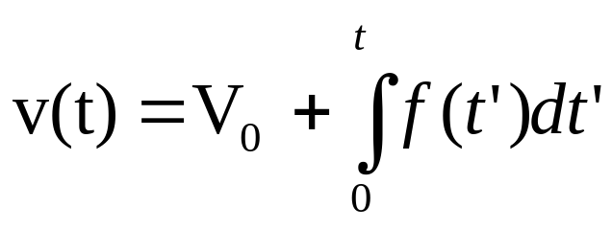
Applications --- Solving differential equations
The simplest case:
Solution:
Initial condition:
v(0) = V₀
The circuit:
V₀
t = 0
+ −
R₂
R₁
C=1/R₁
R₂
−
+
−
+
f(t)
+
−
+
v(t)
−

Slide 26
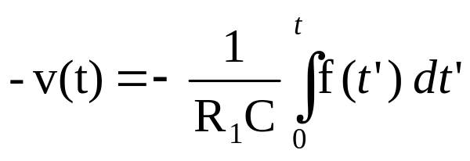
Identify each stage of the circuit
V₀
t = 0
+ −
R₂
R₁
C=1/R₁
R₂
−
+
?
−
+
f(t)
+
−
-v(t)
?
+
v(t)
−
Integrator
Inverter

Slide 27
Identify the initial condition
v(0) = V₀
V₀
t = 0
+ −
R₂
R₁
C=1/R₁
R₂
−
+
−
+
f(t)
+
−
-v(t)
+
v(t)
−
Integrator
Inverter

Slide 28
Identify the equation
Solution:
v(0) = V₀
V₀
t = 0
+ −
R₂
R₁
C=1/R₁
R₂
−
+
−
+
f(t)
+
−
-v(t)
+
v(t)
−
Integrator
Inverter

Slide 29
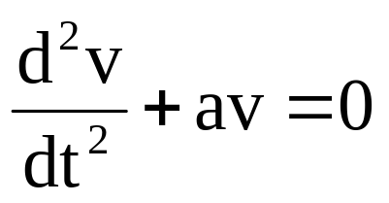
Second order equation
Differential equation:
v(0) = V₀,
v’ (0) = 0
t = 0
V₀
t = 0
dv
− +
C=1/R₁
dt
−
+
C=1/R₁
R₁
−
+
R₁
d²v
+
v(t)
−
aR₂
dt²
R₂
−
+
− a v(t)

Slide 30
Analysis of a circuit with an ideal operational amplifier is drastically simplified
Infinite gain --> virtual short
v₁
−
+
v₂
+
v_{out} = A (v₂-v₁)
−
0
Infinite input impedance --> virtual open
Zero output impedance --> forget about the load

Slide 31

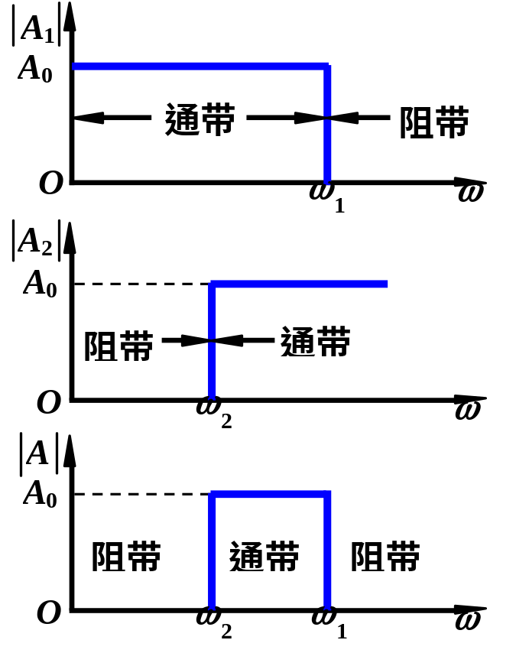
Filters with Op-Amp

Slide 32
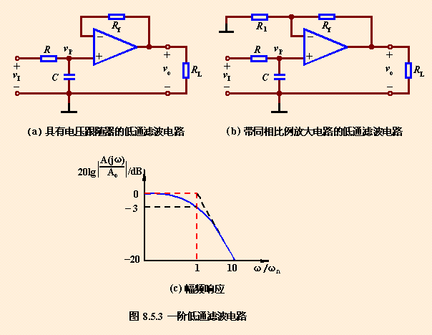
Low pass filters

Slide 33
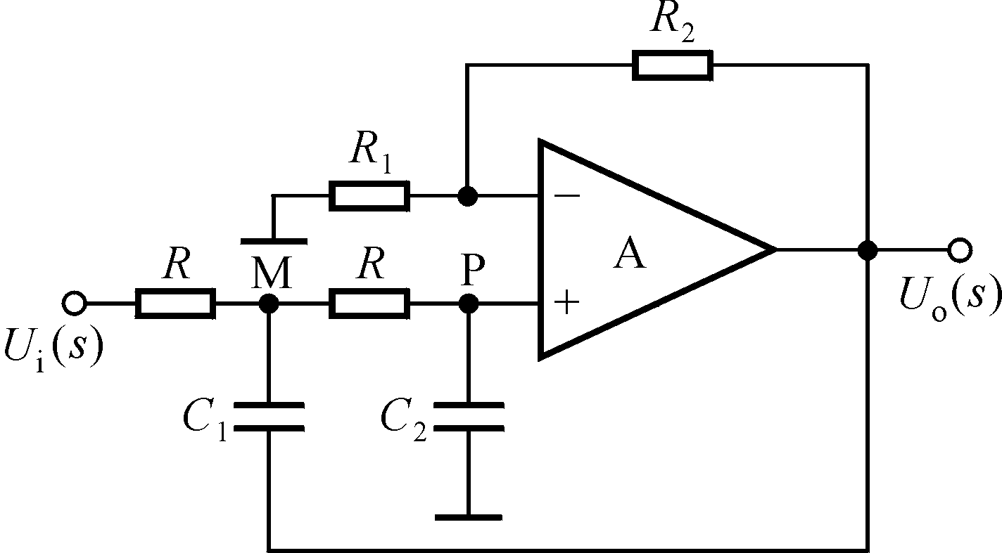
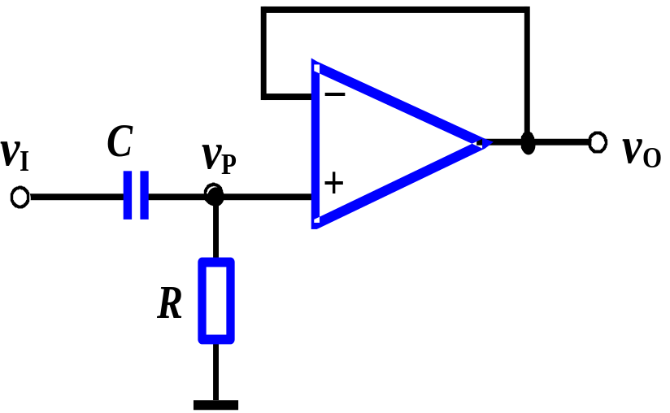
LPF
HPF

Slide 34
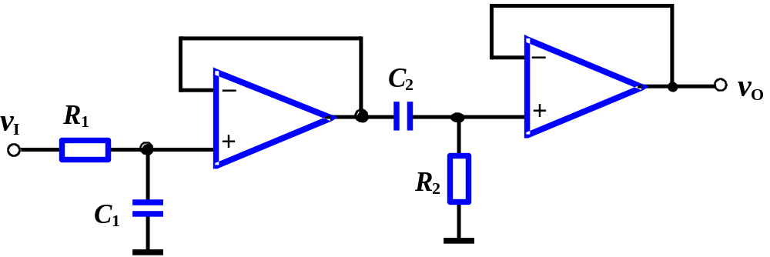
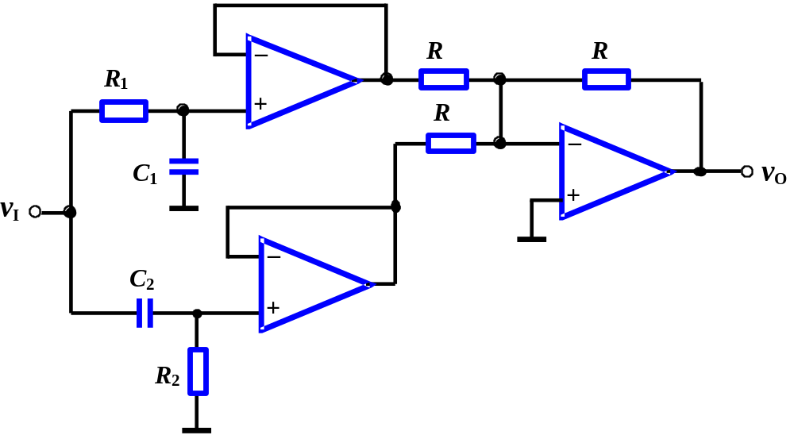
BPF
LPF & HPF in series
BSF
LPF & HPF in parallel

Slide 35
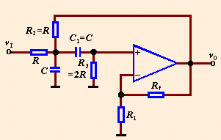
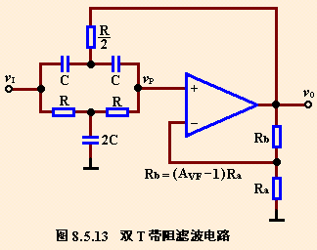
BPF
BSF

Slide 36
Homework
Problems 4.17, 4.24, 4.27, 4.29, 4.32

